Slide 1
Non-Volatile Memory Allocation

Slide 2
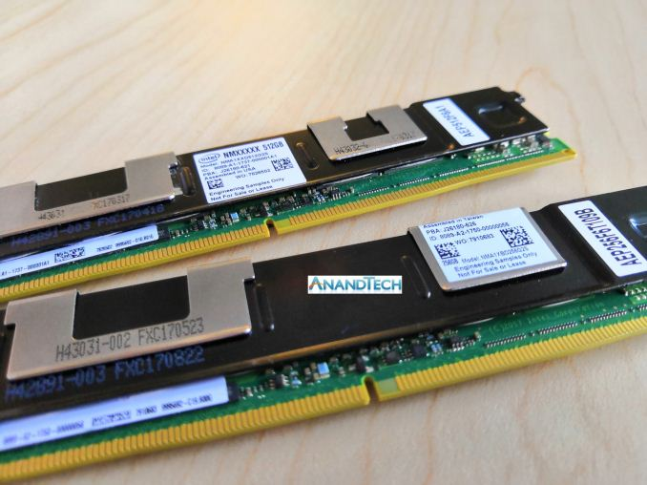
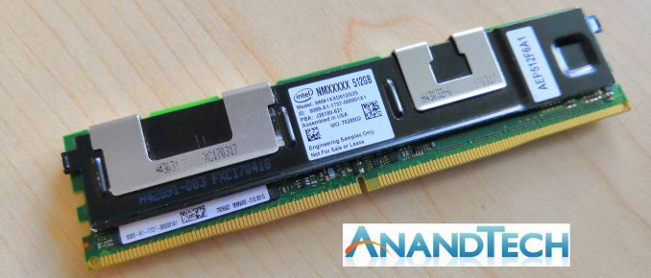
NonVolatile memory (apache Pass)

Slide 3
Non-volatile memory
Byte addressable
Accessed/used similar to DRAM
Write is substantially slower than read
Higher latency (~2x)
Lower bandwidth (~20%)
Read is somewhat slower than DRAM read (~2x)
CPU sees it as memory; subject to caching behaviors

Slide 6
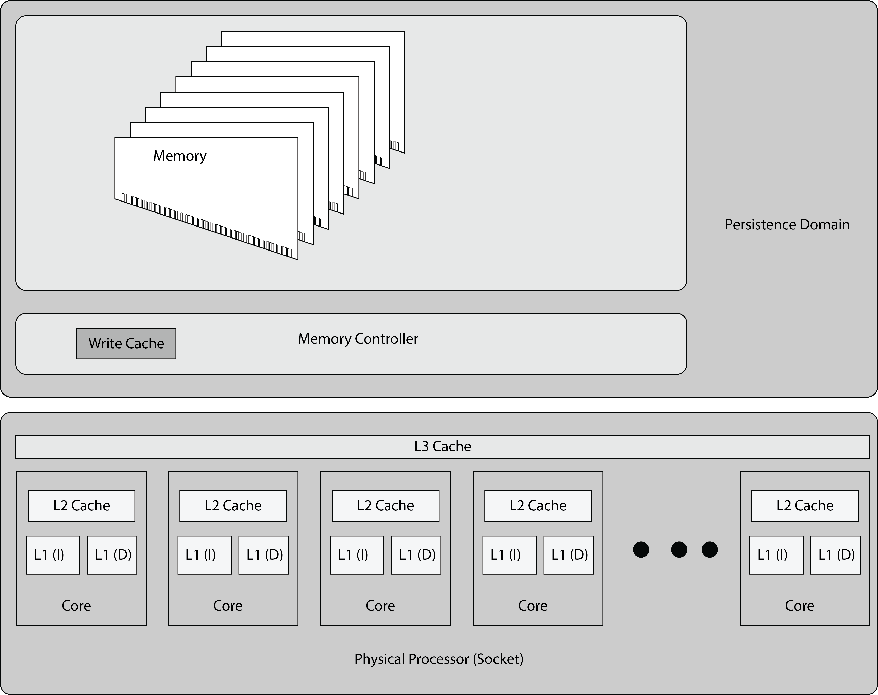
Persistence domain

Slide 7
Memory Allocators
Fundamental to resource allocation
Jemalloc – state of the art memory allocator, scales well across processors, used by the PMDK; PMDK has strong consistency guarantees for the object allocator
nvm-malloc – alternative allocator for non-volatile memory (Hasso-Plattner Institute) with excellent performance and strong consistency guarantees
glibc malloc – The standard GNU memory allocator (for DRAM)
pmcto malloc – From the PMDK, it offers open-to-close consistency only (so no fence/flush except during shutdown)
pmobj malloc – From the PMDK, it offers object consistency with an application level API for flush/fence.

Slide 8
Allocation Only – 64 bytes

Slide 9
Allocation only – 256 Bytes

Slide 10
Allocator Results (Alloc/Free/Alloc)

Slide 11
Alloc/free – 256 bytes

Slide 12
Observation: deferred fencing wins

Slide 13
NVm bottlenecks

Slide 14
Fencing is expensive

Slide 15
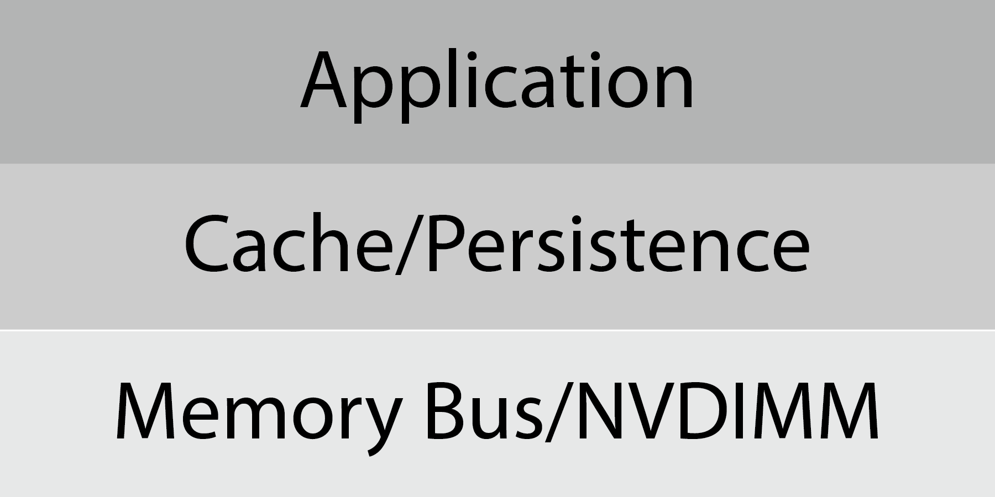
Domains
Application Transaction Layer – required for application consistency with persistence
Processor Layer
Flush – pushes data into the pipeline
Fence – ensures data is within the persistence domain
NVM Layer
64 bytes – cache line size, memory write back size
256 bytes – NVM storage size

Slide 16
questions
What is the benefit of deferring:
Flush
Fence
What is the correct usage pattern
Sequential write
Random write
How do we balance:
Efficiency versus crash consistency
Capacity versus Persistence

Slide 17
Allocator models
Replace malloc
Not enough for application crash consistency
Applications can make consistent
New API
Expose transactional memory interface (PMDK object model, for example)
Expose flush/fence interfaces
What are the right guarantees here?

Slide 18
Observations
Best solution will offer:
No persistence guarantee upon return from malloc unless needed by allocator
Aggressive flush (to fill pipeline) and conservative SFENCE
SFENCE is needed when the allocation might be externally visible.
Many operations fence memory (e.g., atomics)
Mechanisms for applications to move to persistent memory
Use appropriate consistency guarantee mechanisms at each layer:
They’re all “transactional memory”
Versioning
Shadowing
Logging
Atomics

Slide 19
Other areas to explore
Using TSX for Cache Pinning
Changes cannot become visible until XEND
XEND is ordered by SFENCE (persistence)
Good for small (< 4KB) operations
Excellent for tiny (<512 byte) operations
Build a TSX based NVM log
Has been done before (simulation); need to do it on real memory
Useful
Performant

